Slide 1

WiFi NETHOME PLUS application
KITE units

Slide 2

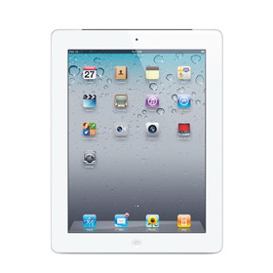

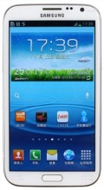
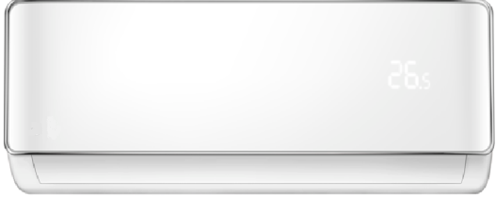




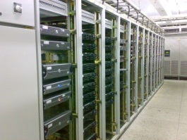
Remote control mode
IOS Android
Router
Wifi Module
Cloud server & Internet

Slide 3
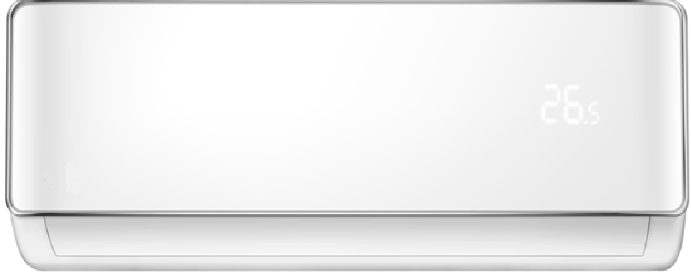
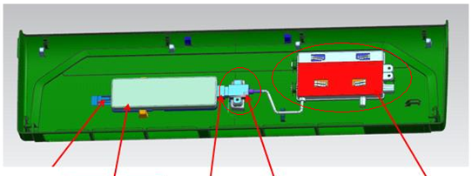
WiFi Module
USB Connection
Display Board

Slide 4
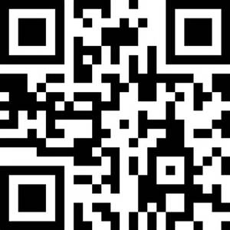
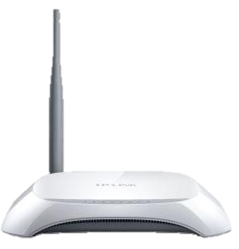
You will need:
Mobile phone
Operation system: Android (above version 3.1) or IOS (above version 6.1)
Mobile device storage space: at least 20MB.
AC with WIFI module
Unique QR code available on module which can identify the unit to build the connection between AC and Router
Wireless Router
Common Home Wireless Router available in the open market.

Slide 5
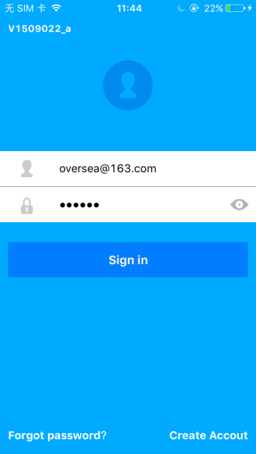
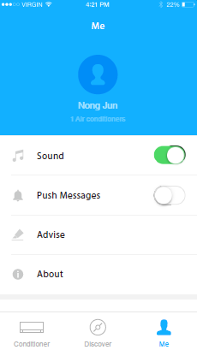
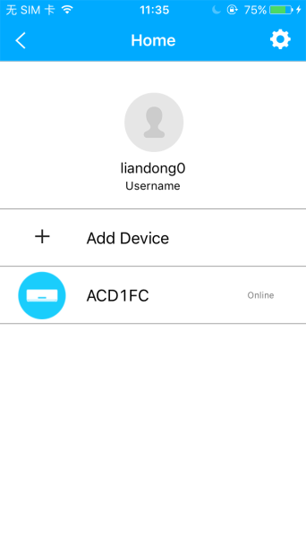
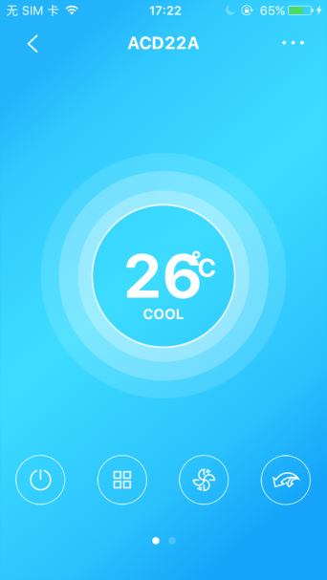
Software NETHOME PLUS
You can download the software “NETHOME PLUS” from App store on iOS system or Google Play on Android system

Slide 6
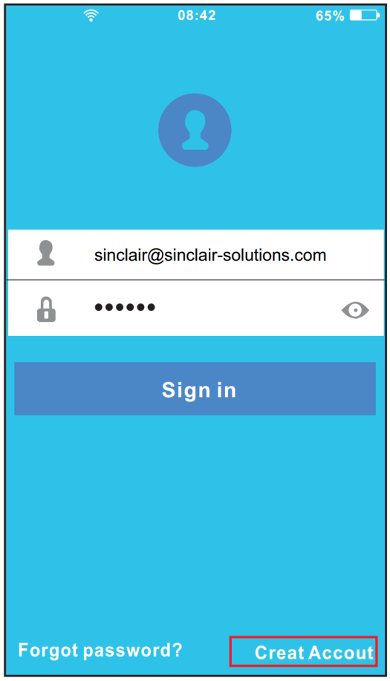
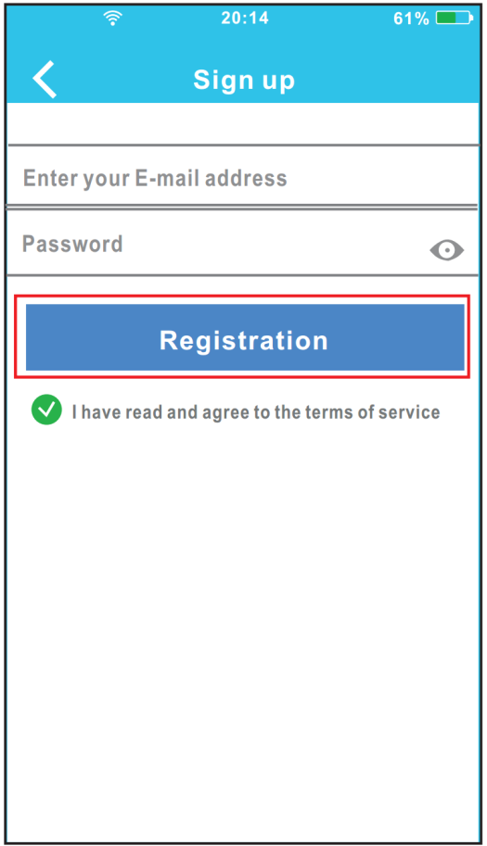
How to connect
Create new Account:
Open the APP click “Create Account” button and then register a new Account.

Slide 7
How to connect
Setting (Router address Setting)
Turn the unit off then use the remote controller - within 3 minutes seven-times press the LED button until „AP“ appears on the panel

Slide 8

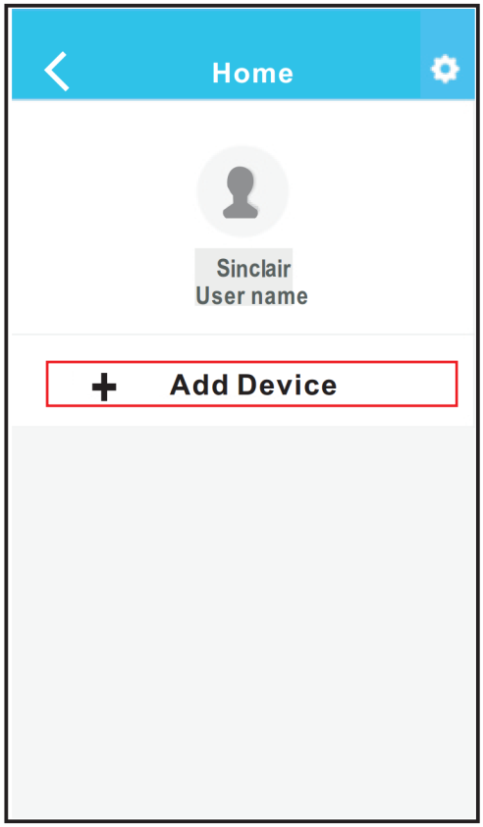
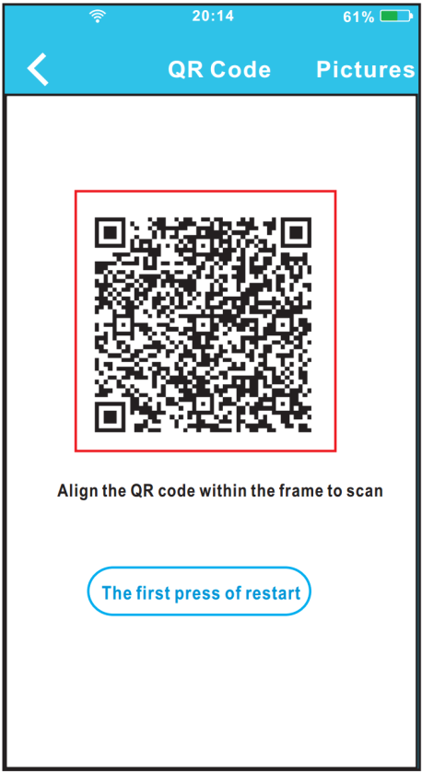
How to connect
Building connection between Air conditioner and Wireless Router by APP
Input the username and password, click „Sign in“ button, enter the Terminals surface, click „Add Device“ and then scan QR Code which is provided with WIFI module
Notice: Make sure your mobile connect to your own WIFI when setting

Slide 9
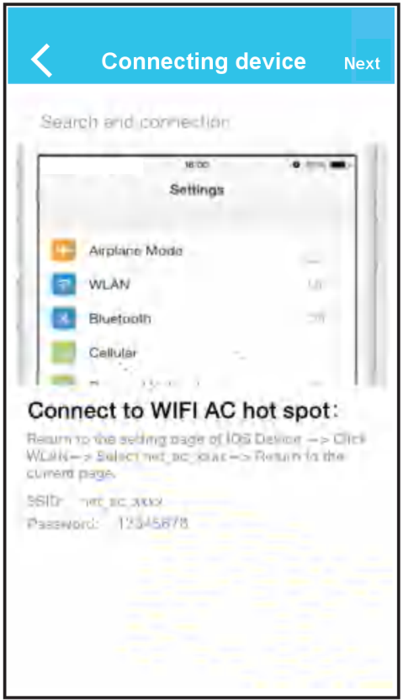
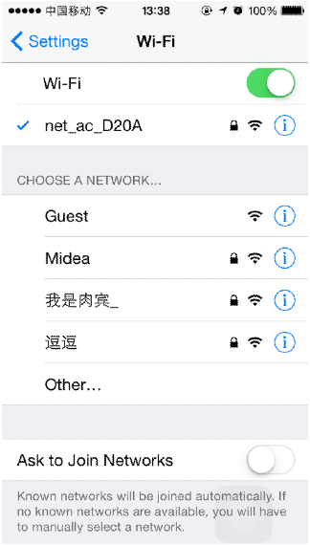
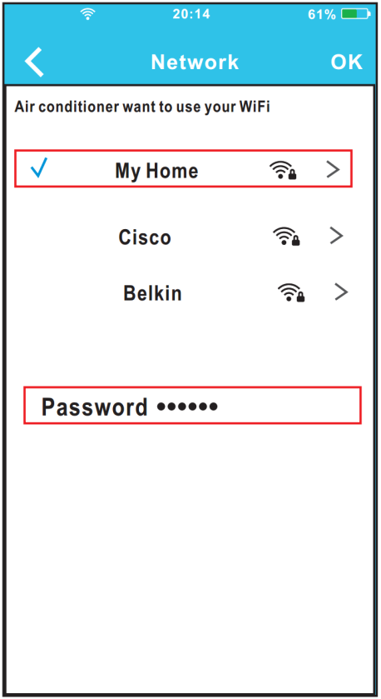
How to connect
When you have Apple device:
Return to the setting of Iphone. Choose WIFI, and Select net_ac_XXXX. Enter default password: 12345678 and click „Join in“ then return to APP, click „Next“ button. Choose your own WiFi network, for example My Home. Enter your own WiFi router password and click OK button. Connection should be successful now

Slide 10

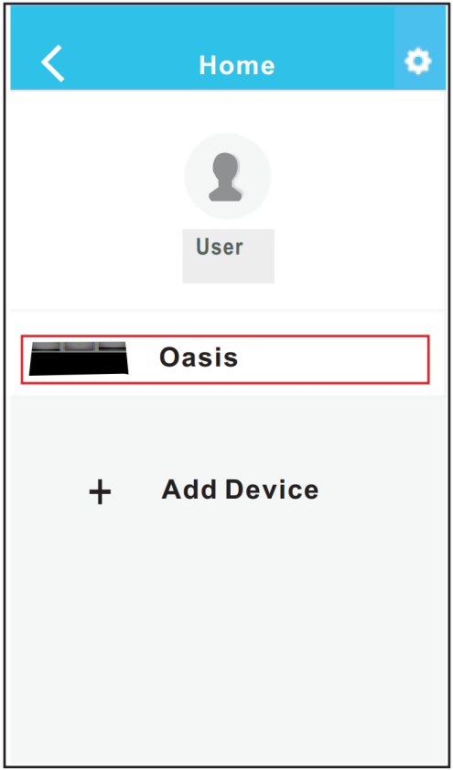
How to connect
When you have Android device:
APP will enter to network directly. Select your own WiFi network, for example My Home. Enter your own WiFi router password and click OK. Configuration Success, you can see the device on the list.

